Slide 1
INDIAN CRICKET TEAM DATABASE & ANALYTICS
TEAM :
CHANDRA SEKHAR KATIPALLI
BHASWANTH ADITYA KANAPARTHI
NITHIN KUMAR
VARUN MADALA
JAYA PRAKASH NARAYANA GANGINENI
BALAKRISHNA REDDY

Slide 2
CONTEXT
Web Scraping – Data Collection
Data Cleaning
Creating Database
ETL process
Power BI Report

Slide 3
STEP 1:DATA COLLECTION
Source – ESPNCricinfo
Tools - Brightdata.com [Web crawler]
We are taking EspnCricinfo as the source.
We are using webcrawler method to collect data from the source using tool Brightdata.com
The tool uses Javascript to crawl the website and collect data into different formats like Excel, Json, etc.

Slide 4
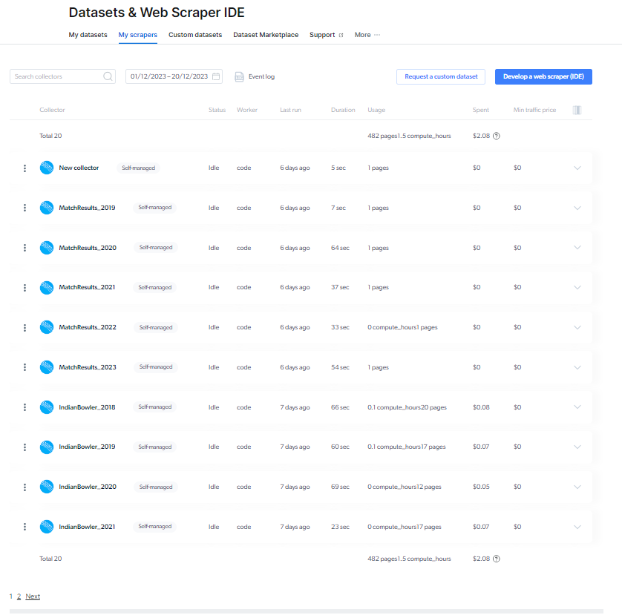
Web Crawlers

Slide 5
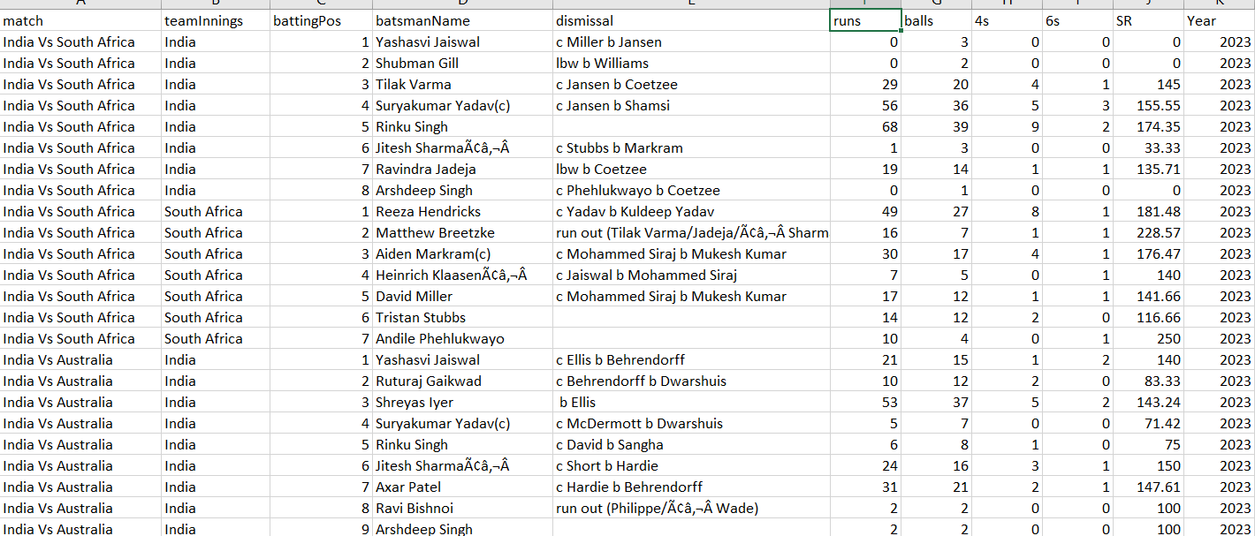
Batsmen Record

Slide 6
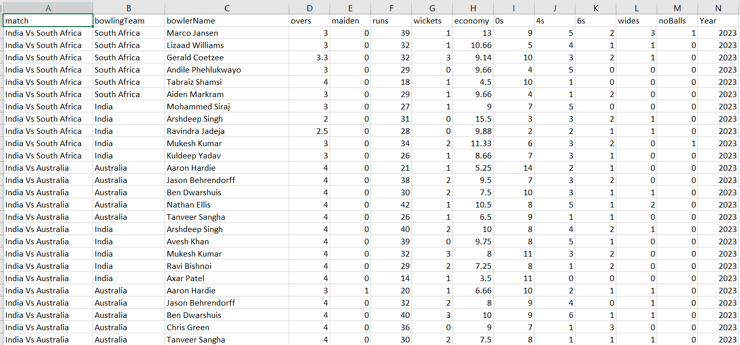
Bowler Record

Slide 7
STEP 2: DATA CLEANING
After the collection of data, we have analyzed the data to check if we have any missing values.
In the same process, we have added some additional columns for our analysis.
After that, we have split the data into multiple tables like batsman data , bowler data and match results.

Slide 8
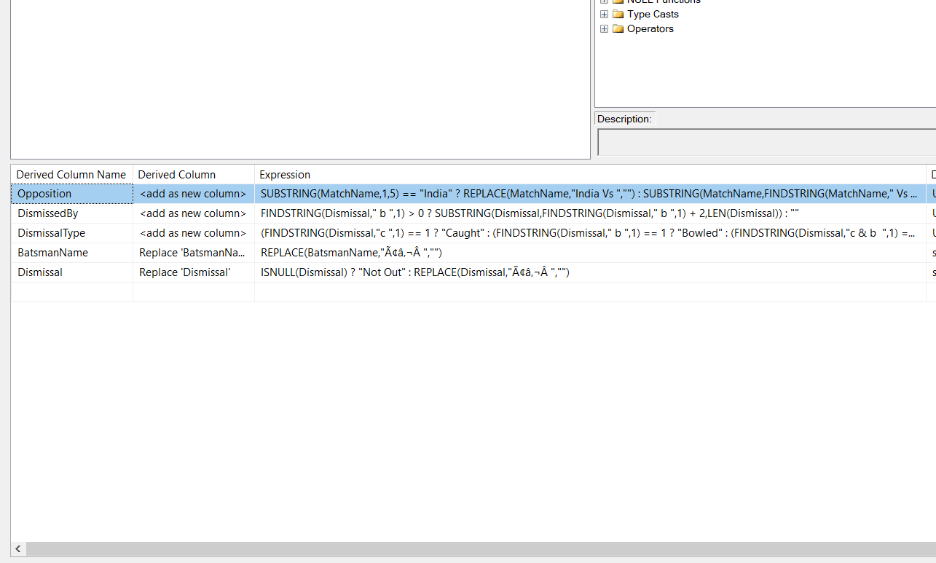
DERIVING COLUMNS AND DATA CLEANING

Slide 9
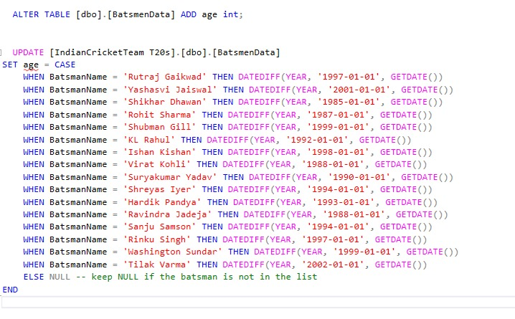
BATSMEN DATA MODIFICATION:

Slide 10
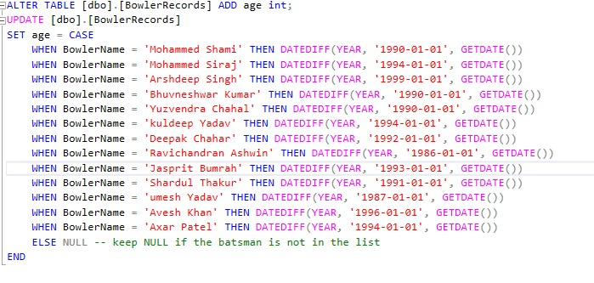
BOWLER DATA MODIFICATION:

Slide 11
STEP 3: ETL [Extract Transform Load]
Using SQL server integration services, we will transfer and transform our data.
Now we will set the data types using data conversion.
After setting the data types , we will use the derived columns to add any required columns using existing columns like Bowler name, Age, Batsman name, etc.
After deriving the columns, we will use the conditional split and split the data into different tables.
Later, we will push the data into tables in database using OLDB destination assistant.
Then, using the OLDB destination assistant as input we will generate the desired database into the SQL server.

Slide 12
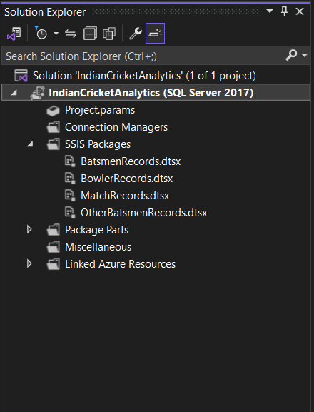
VISUAL STUDIO SOLUTION:

Slide 13
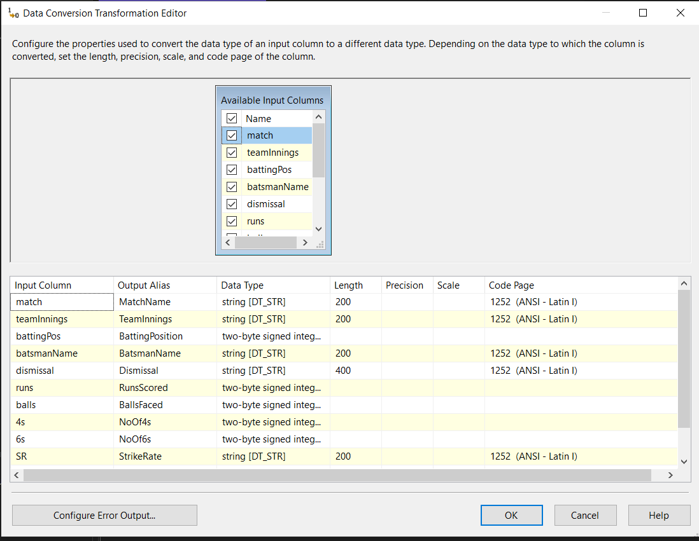
DATA CONVERSION

Slide 14
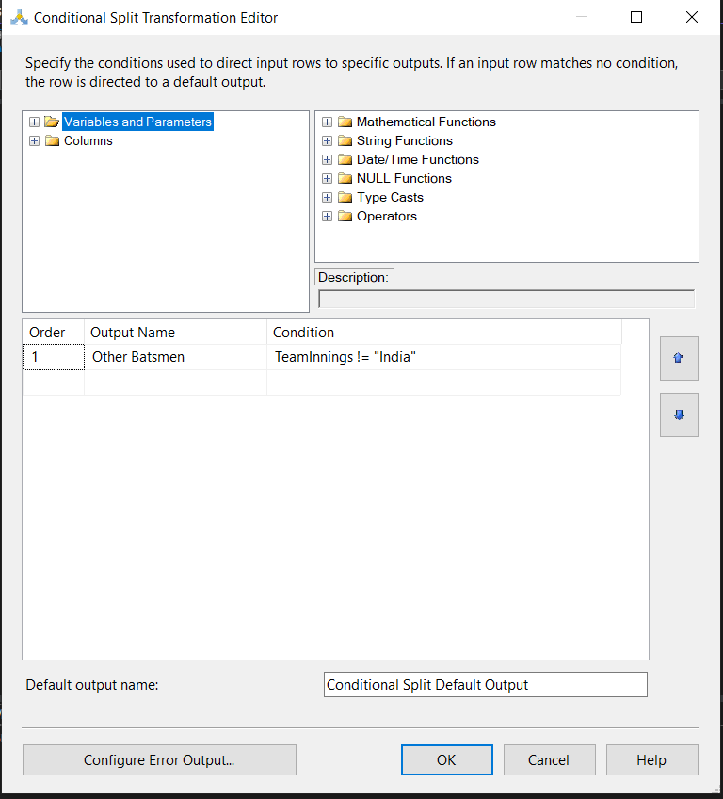
CONDITIONAL SPLIT

Slide 15
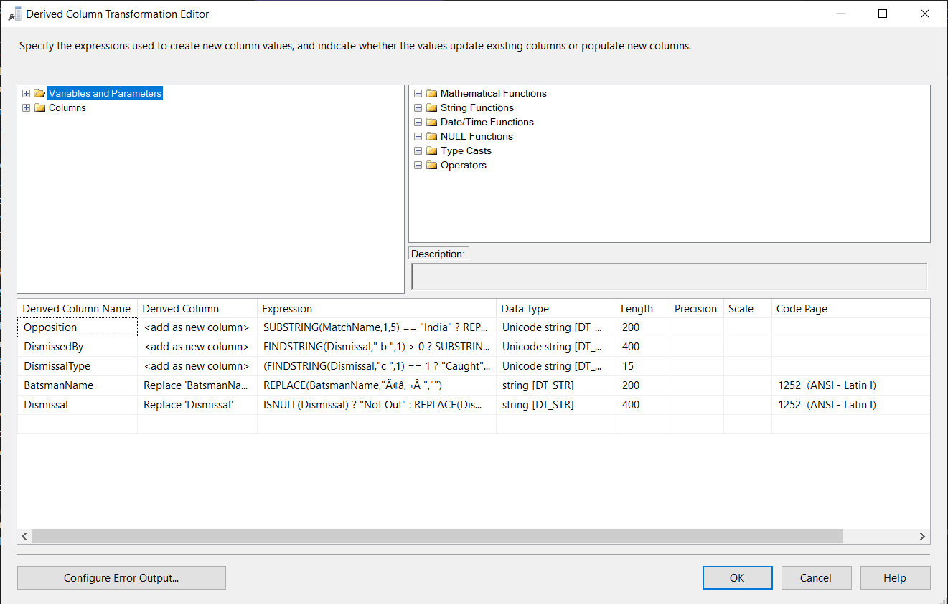
DERIVED COLUMN TRANSFORMATION:

Slide 16
STEP 4: Power BI Reports
Firstly, we will import our database into Power BI.
Next we will analyze the data and perform actions to achieve the desired results.
Results:
Predicting the best performing playing 11 based on opponents.
Batsman performance by factors such as Age, Runs, Type of dismissal
Bowler performance by Age, Economy and Average.
Finding the weaknesses of the Batsmen and Bowlers and adjusting the playing 11 accordingly.
Bowler – Batsmen Head to Head Statistics

Slide 17
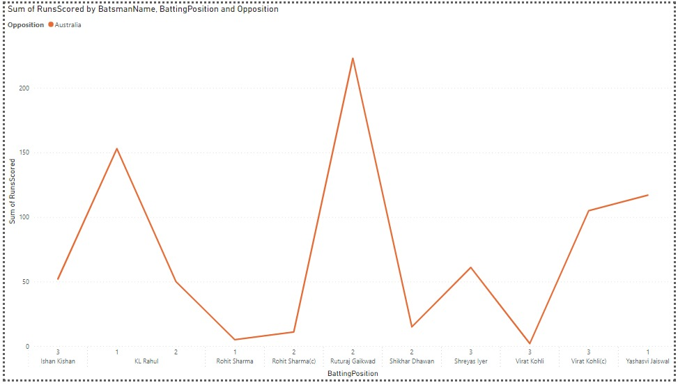
PLOT BETWEEEN TOP ORDER BATSMEN vs OPPONENT

Slide 18
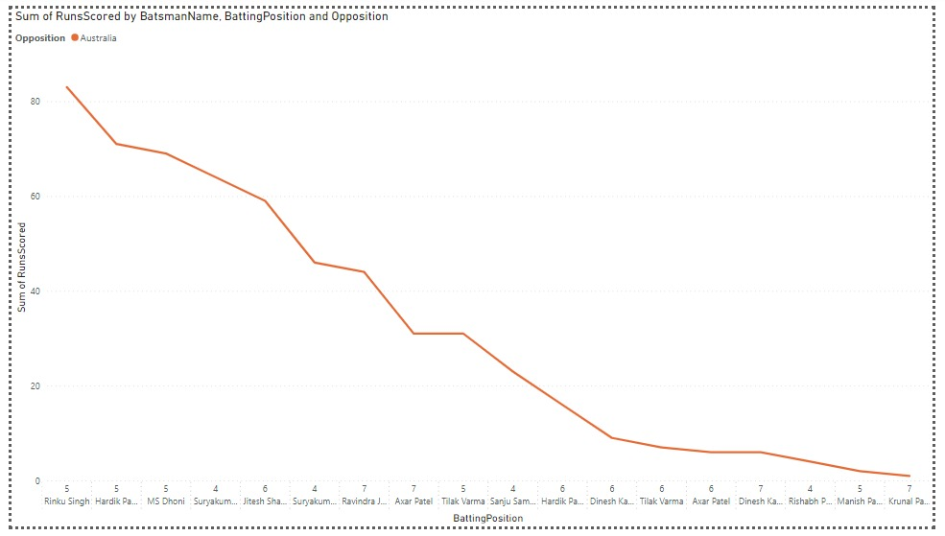
MIDDLE ORDER PERFORMANCE vs OPPONENTS

Slide 19
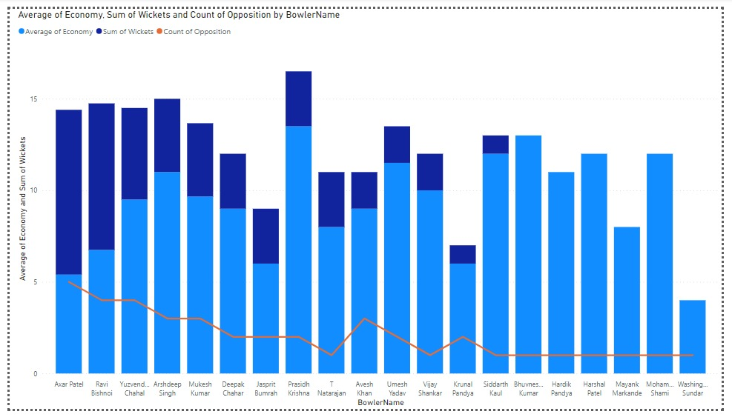
BOWLER PERFORMANCE BASED ON OPPONENT

Slide 20
As Our PowerBi Reports are Dynamic. So, it was not feasible to present every report. But Reports can be found in PowerBi project solution.

Slide 21
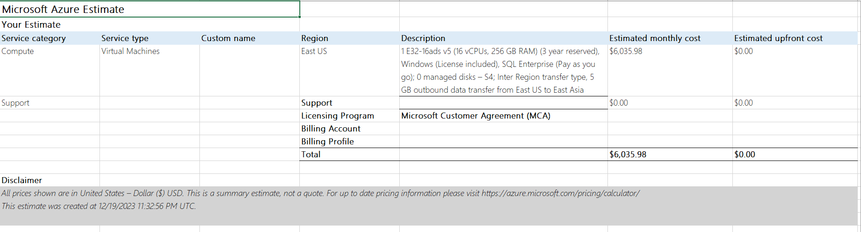
STEP 5: CLOUD COST ESTIMATOR
SQL SERVER COST ESTIMATION

Slide 22
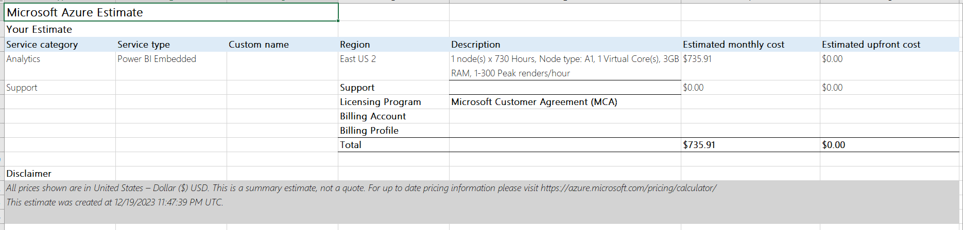
POWER BI SERVICE COST ESTIMATOR PER MONTH:

Slide 23
thank you

